Slide 1
Mathematical Modeling of
Human, Social and Natural Systems:
Relevance for Environment and
Climate Change Research
Mohammod Irfan
BEN Bimonthly Webinar 10
March 30, 2024
The Frederick S. Pardee Center for International futures,
University of Denver,
Denver, Colorado, USA

Slide 2
Presentation Outline
Introducing the Topic
  Models, motivations, model making
An Example with a Multi-system Dynamic Model
  International Futures system (IFs)
Model Applications
  Broad range of applications
  Specific examples
Wrapping Up
  Cautions, Recent developments, Resources
Notes:
Question: interpretation of the dynamics (age-groups; population n change etc), Sarewitz

Slide 3
Introducing the Topic
Models
  Definition
  History
  Typology
Motivation
  What models can and cannot do; cautions and caveats
Model Making
  Scope
    Human, social and natural systems
    Structure, behavior and boundaries
  Process
    Measurement, Data, analysis, and algorithms
Notes:
Question: interpretation of the dynamics (age-groups; population n change etc), Sarewitz

Slide 4
Models
Models are simplified representations used to understand, predict, or explain complex phenomena
Model building has a long history
  Baudhayana, Aryabhata, Varahamihira, Pythagoras, Euclid, Archimedes
  Al-Kindi, Al-Khwarizmi, Copernicus, Kepler, Galileo
Models have come a long way
  Advances in computing (computer-based modeling is about 50/60 years old)
  Availability of (big) data
  Models can now capture complex interactions within and across coupled systems
Scientific models
  Physical, conceptual, mathematical, and simulation models
  Quantitative and empirical models versus theoretical/analytical models
  Dynamic or distributional models
  Equilibrium or emergence

Slide 5
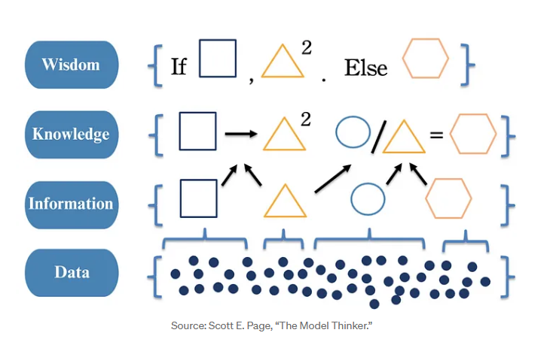
Motivations
What models can do
  Study the patterns, trends and distributions
  Understand the causality and the correlates
  Forecast, project, predict, foresight
  Optimization, assess risks, monitor progress, evaluate programs
  Help make informed, evidence-based decisions
  Learning tools
What models do not, can not, should not do
  Do not do prophecy
  Cannot account for all variables (measurements or data issues)
  Should not substitute human judgement
Cautions and caveats
  Models are as good as the assumptions and underlying data (all model is…)
  Simplicity is not just recommended, it is required
  Uncertainty and confidence interval
  Conceptual, empirical and algorithmic errors, GIGO
  Bias and misinterpretation of model results
  Validate and verify
  Always update your data and assumptions, models as living knowledge repositories

Slide 6
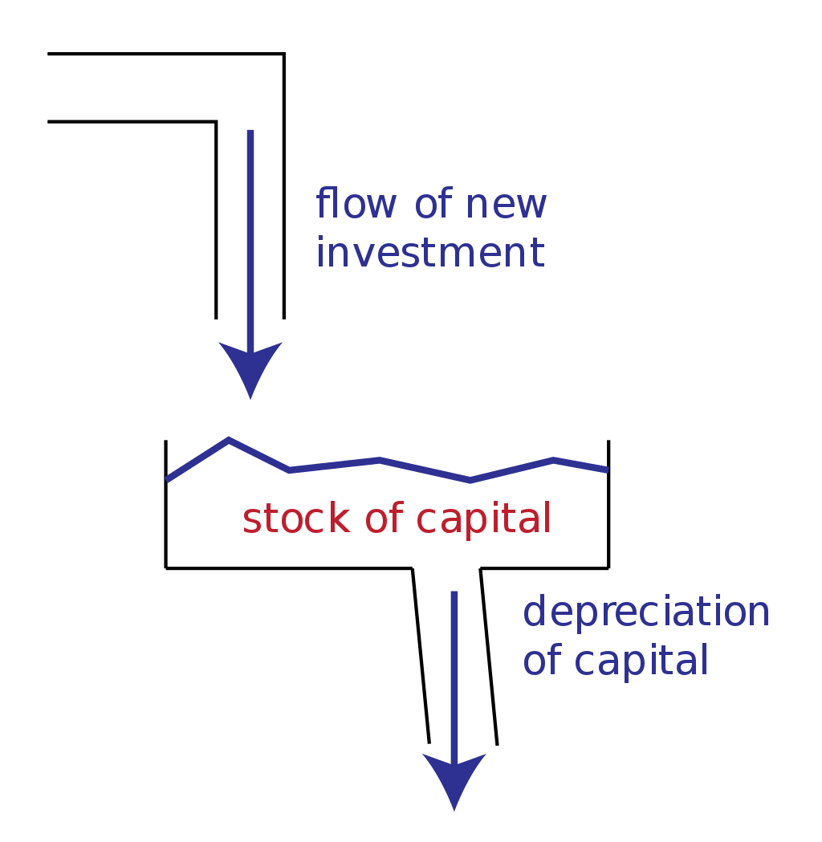
Model Making
Always start with a question
    What do we want to know, dependent variable, driver(s)
    What is the structure of the system, what are the boundaries
    Model horizon, spatial coverage
    Tools and techniques
    Scaling
    Dynamics: stocks and flows; Patterns and archetypes; Equilibrium and steady state
    Interlinkages, feedback
    Optimization
    Emergence and complexity
  Process
    Conceptual analysis, Measurement (operationalize)
    Data, Analysis, Patterns and trends, Causal relationships and correlations
    Model outline (structure and boundaries), develop algorithms
    Model run, Scenarios
    Sensitivity, Validation and verification
  Multi-system models
    Human, natural and social systems coupled in one modeling platform
Notes:
Question: interpretation of the dynamics (age-groups; population n change etc), Sarewitz

Slide 7
Multi-system Model: An Example
A Long Horizon Integrated Assessment Model
  International Futures system (IFs)
IFs Modules
  Economy, demography, education, health
  Agriculture, Energy, Environment, Infrastructure
IFs application (needs to go in application area)
  Many models and ensemble; multi-dimensions analysis; multi-system dynamics; big data, machine learning, generative models
Using IFs
  free and open-source models, scenarios and scenario databases
Notes:
Question: interpretation of the dynamics (age-groups; population n change etc), Sarewitz

Slide 8
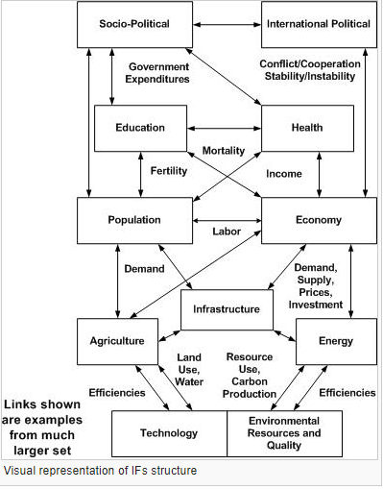
International Futures (IFs)
A large-scale integrated global modeling system.
Facilitates dynamic analysis of near through long-term country-specific, regional, and global futures.
Covers multiple interacting issue areas: demography, health, education, economy, energy, agriculture, infrastructure, international politics and environment.
Notes:
Back up

Slide 9
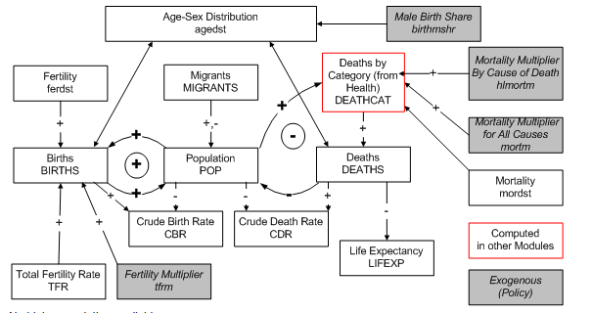
Demographic Model
Cohort component model
Population projected by age and sex
Models births, deaths and migrations
TFR driven by women’s education, income among others
Mortality and morbidity

Slide 10
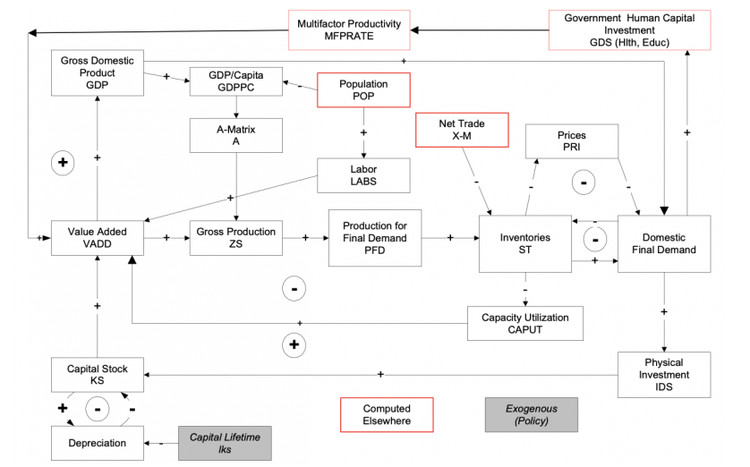
Economic Model
The economic model represents supply, demand, and trade
General equilibrium model
Six economic sectors: agriculture, primary energy, raw materials, manufactures, services, and information/communications technology.
Labor by skill level
Intersectoral flows (input-output system) and final demand
Social Accounting Matrices
Government revenue, consumption and transfer
Data from the Global Trade and Analysis Project (GTAP)

Slide 11
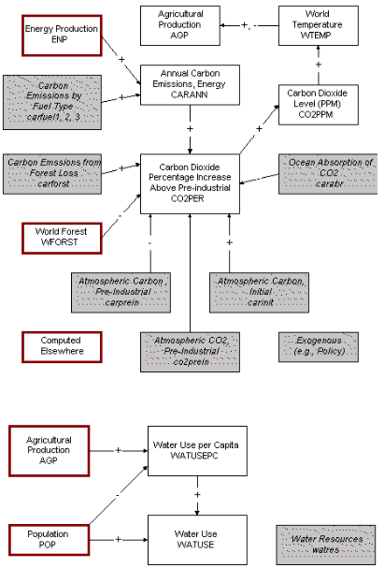
Physical System Models in IFs
Atmospheric carbon dioxide is function of emissions from fossil fuel burning. Water use is primarily a function of agricultural sector size (and therefore on irrigation). Forest area is dependent upon the rate of conversion of forest to crop land and grazing area.
The energy submodel determines fossil fuel use, and the agricultural model determines agricultural sector size and land conversion patterns. See those models for discussion of dominant patterns and of control parameters.
The larger environmental model provides a more extended model of carbon dioxide, including oceanic absorption rates and possible impact of build-up on global temperature and agricultural patterns.

Slide 12
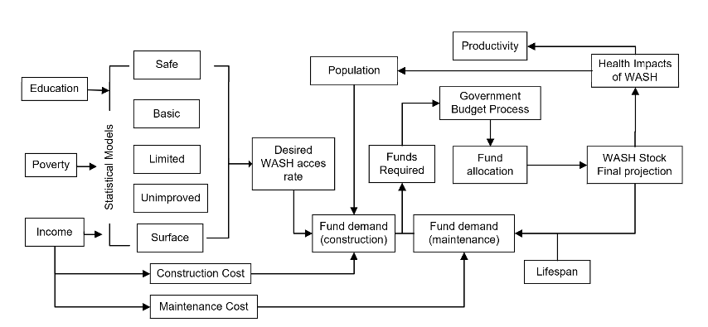
Water and Sanitation
5-tier Water and Sanitation services, rural and urban
Distribution of population by type of services
Logistics model to project distribution categories driven by poverty, income ad education
Cost and government spending
Forward linkage to diarrheal deaths, productivoty

Slide 13
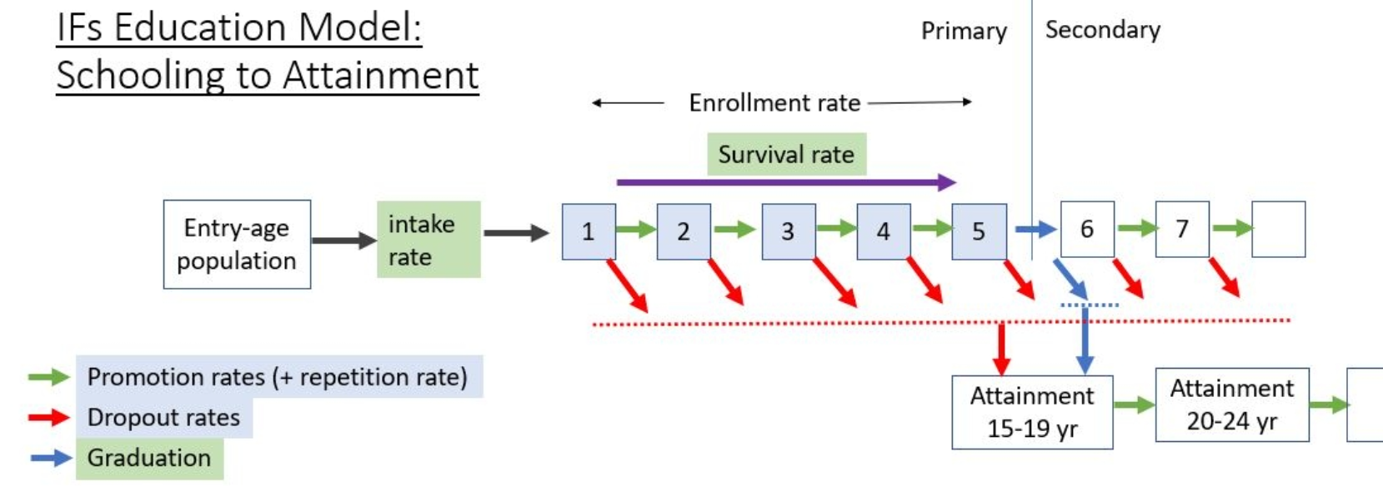
Education
Model
Integrates schooling flows and adult attainment
Represents primary, secondary (upper and lower) and tertiary schooling in 188 countries
Student flow rates for boys and girls (separate) for entrance, graduation or enrollment
Flow rates driven by income level and government spending
Svchooling outcomes drive adult attainment
Model coupled with population, economy (productivity; finance) and other variables

Slide 14
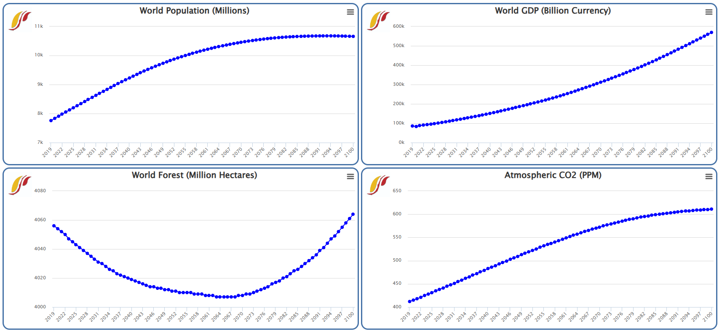
IFs Projections
Notes:
Question: interpretation of the dynamics (age-groups; population n change etc)

Slide 15
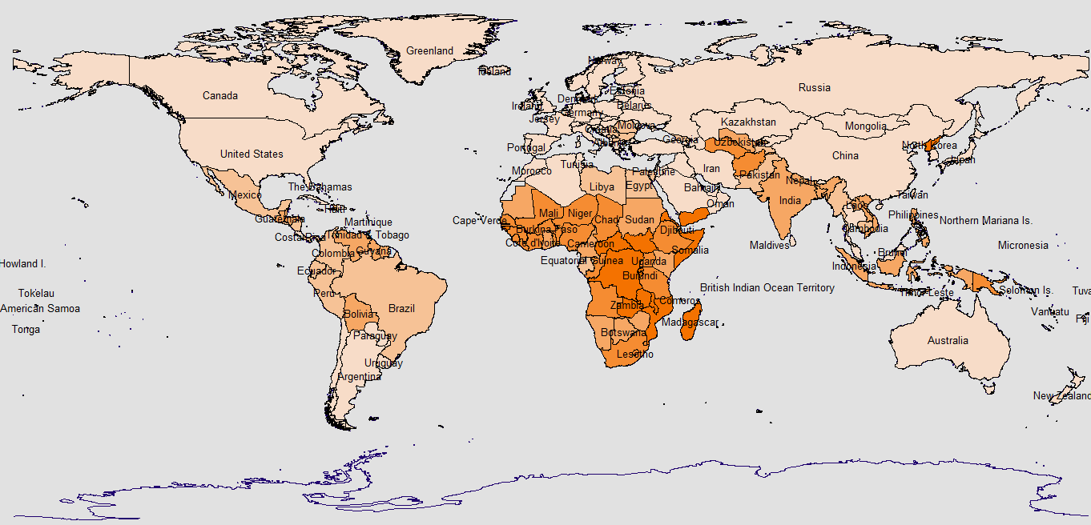

Global Poverty
Percentage of people living in extreme poverty by country in 2017 or a nearby year
Notes:
quiver

Slide 16
How to get IFs
IFs is a freely available and open-source application software
There is a graphical user interface
There are two version
Web version
  IFs Main Menu (du.edu)
  https://www.ifs.du.edu/ifs/frm_MainMenu.aspx
Desktop version (Windows PC)
  Can be downloaded from https://ifs02.du.edu/IFs%20with%20Pardee%208_19%20March%2014%202024.zip
  Install at your desktop using instructions shared earlier
Notes:
Ask if that is okay?

Slide 17
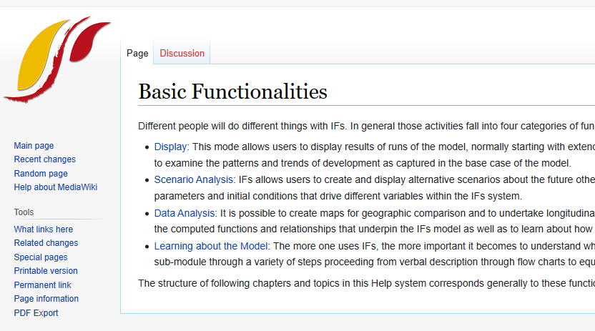
Getting Started with IFs
Menu-driven GUI
Extensive help system
Many options are self explanatory
Block diagrams of modules
Driver diagrams
Notes:
Ask if that is okay?

Slide 18
Model Applications
Broad Range of Applications
Specific Examples
  Models for measuring and mapping socio-economic progress
  Models for environment and climate change research
Bangladesh Applications
IFs use
Notes:
Question: interpretation of the dynamics (age-groups; population n change etc), Sarewitz

Slide 19
Broad Range of Applications
Disaster forecasting
  Floods
  Extreme weather events
International Politics
  Conflicts and threats
  Global transitions
Demography
  Demographic transitions
  Aging, demographic dividends
  NYT article on peak and depopulation
Epidemiology
  COVID projections (need for PPE, hospital beds, ventilators)
Economics and Finance
  Employment, inflation, growth forecast, Early warning systems for financial shock
Engineering
  Tolerance of bridges and structures
  Economic benefits and costs
Agriculture
  Crop yield, food shortage
Notes:
Question: interpretation of the dynamics (age-groups; population n change etc), Sarewitz

Slide 20
Sustainable Development
Monitoring and Measuring Progress
Designing Interventions
  Are targets reasonable
  Resource mobilization
  Externalities
Synergies and Trade-offs
  Externalities
  Synergies and trade-offs
Short-term Impacts and Long-range Outcomes
  Costs, benefits
  Payoffs (with discounting)
Notes:
Question: interpretation of the dynamics (age-groups; population n change etc), Sarewitz

Slide 21
Environment and Climate Change
Environmental accounting
Assess vulnerability to shocks
  Help preparedness
Mitigation challenges
  Growth versus sustainability
Adaptation capacities
  Building capacities
Legitimization of policy targets
  Legitimize policy commitments to 1.5 c goal
  Policy relevance
Forewarn
  Forecast warming by accounting for carbon buildup, radiative forcing
Notes:
Question: interpretation of the dynamics (age-groups; population n change etc), Sarewitz

Slide 22
Bangladesh Context
BIDS
  SAM, CGE
BGD NDC Analysis
  For ICBEN 2020 using IFs
Poverty Trajectories
Energy Transitions
Sedimentation and Sea-Level Rise
  Dr. Dipen Bhattacharya and Md. Khalequzzaman
Notes:
Question: interpretation of the dynamics (age-groups; population n change etc), Sarewitz

Slide 23



IFs Applications
Publication
  Five volume Pardee PPHP Series (Poverty, Education and Infrastructure)
  Books on IFs (Barry B. Hughes)
  Research projects for International Agencies and Governments
  Classroom teaching
  Journal Articles, working papers, model documentation

Slide 24
Wrapping up
Be a skeptic
Recent Developments
Resources
Notes:
Question: interpretation of the dynamics (age-groups; population n change etc), Sarewitz

Slide 25
“Skeptic’s Guide”
Cautions and Caveats
  Be a skeptic
  All models are wrong, some are useful
  Challenge axioms and assumptions
  Check the relevance and recency of data
  Demand to understand the basic algorithm
  Test for sensitivity
  Validate
  Skeptic's_Guide.pdf (mit.edu)
Notes:
Question: interpretation of the dynamics (age-groups; population n change etc), Sarewitz

Slide 26
Recent Developments
Recent Trends in Modelling
  Granularity and resolution, Longer horizon, Coupling and interlinkage
  Many models and ensemble
  Multi-dimensions analysis
  Multi-system dynamics;
  big data
  machine learning (Traditional AI)
  Large Language Models, ChatGPT (Generative AI)
  Participatory modeling
Notes:
Question: interpretation of the dynamics (age-groups; population n change etc), Sarewitz

Slide 27





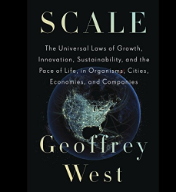
Books and Publications
International Futures Platform
GCAM: Global Change Analysis Model
GTAP Models: Current GTAP Model (purdue.edu)
LEAP: Low Emissions Analysis Platform (sei.org)
DICE (Nordhaus)
AR6 Synthesis Report: Climate Change 2023 — IPCC
The-Sustainable-Development-Goals-Report-2023.pdf
World Economic Outlook (imf.org)
Journals
Nature
Science
Environmental Science & Policy
Databases
World Development Indicators
UNPD
BIDS
BBS
Notes:
Question: interpretation of the dynamics (age-groups; population n change etc), Sarewitz

Slide 28
Thank you!
ধন্যবাদ!
BEN Bimonthly Webinar 10
March 30, 2024

