Slide 1
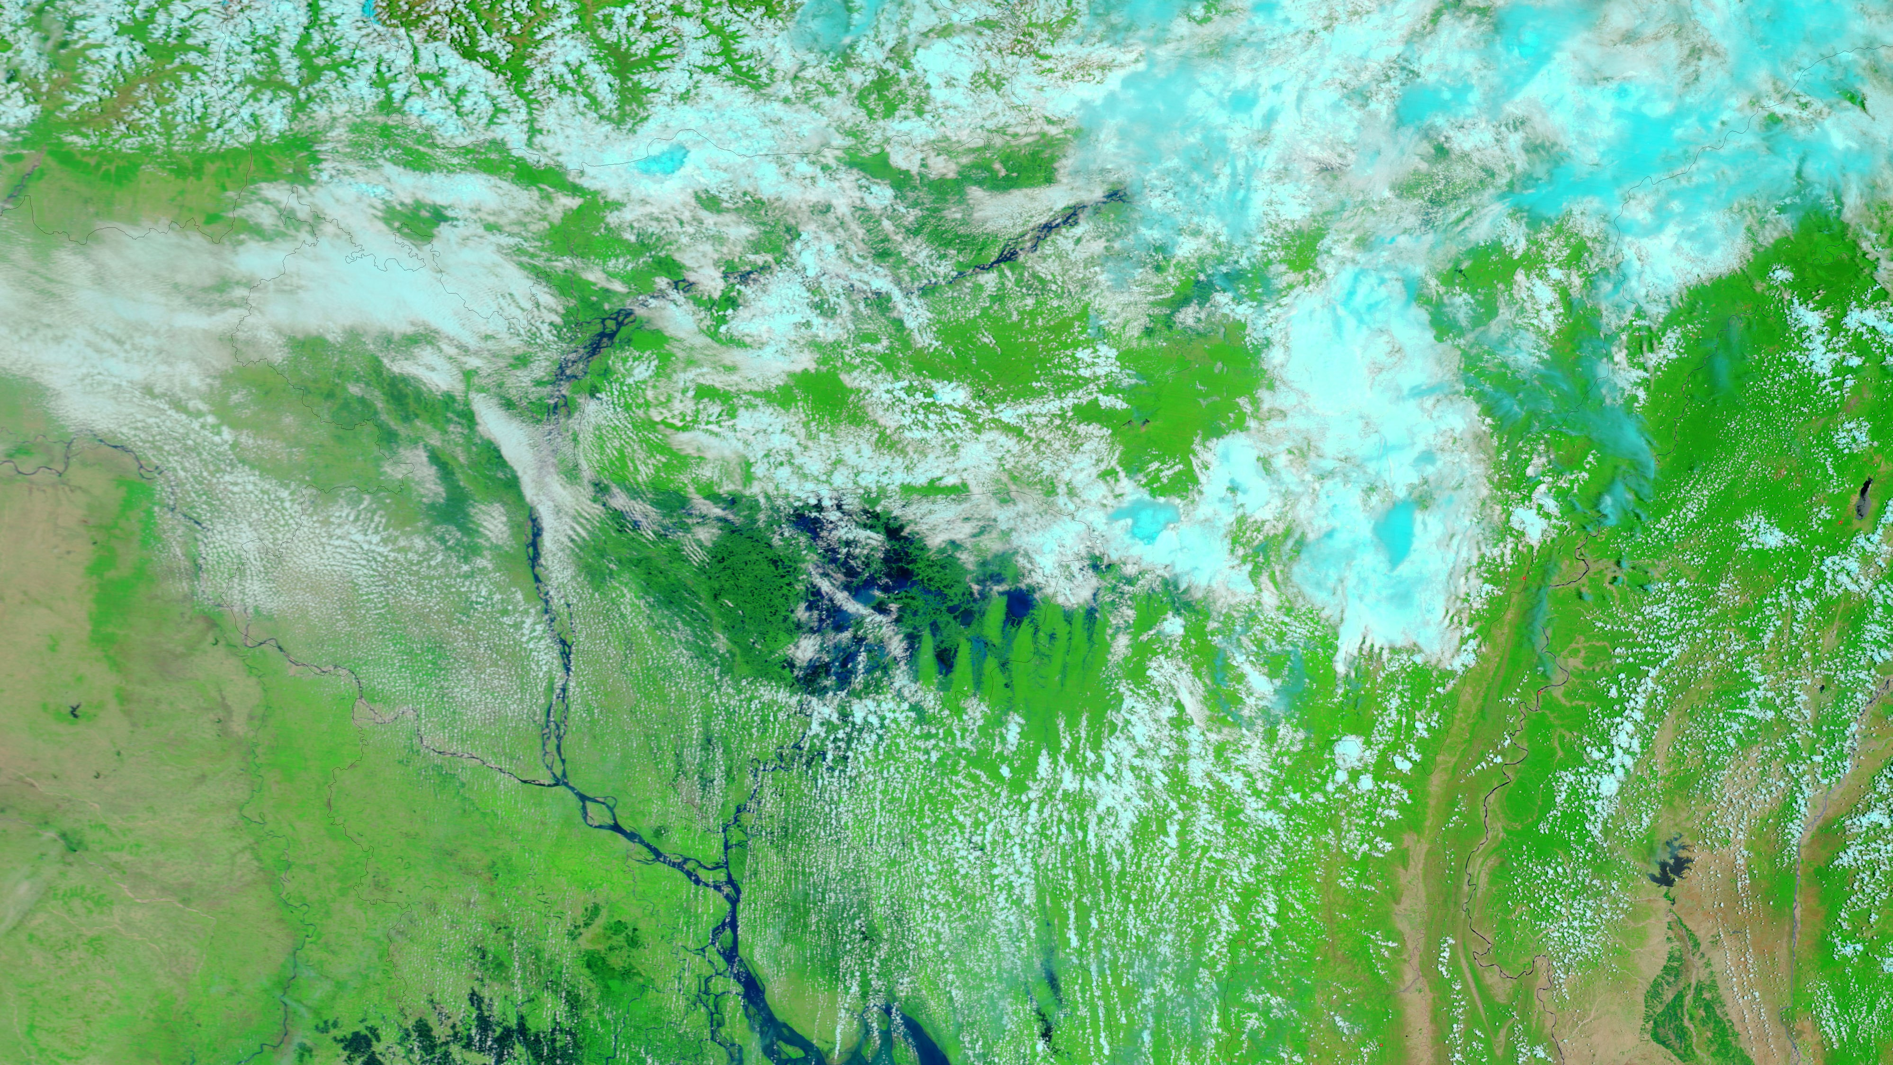
Future Floods in the Brahmaputra River Basin based on Multi-Model Ensemble of CMIP6 Projections
Zahidul Islam, Ph.D., P.Eng
Badrul Masud, Ph.D., P.Eng

Slide 2





Research Team
From Left: Prof. Md. Khalequzzaman, Dr. Badrul Masud*, Dr. Zahidul Islam*, Dr. Sarfaraz Alam, Prof. Md. Mostafa Ali
*Presenting Author

Slide 3
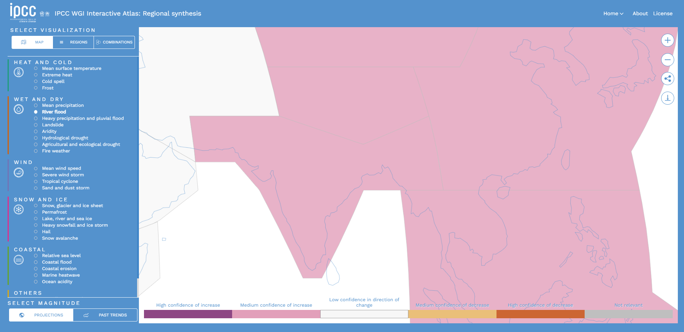
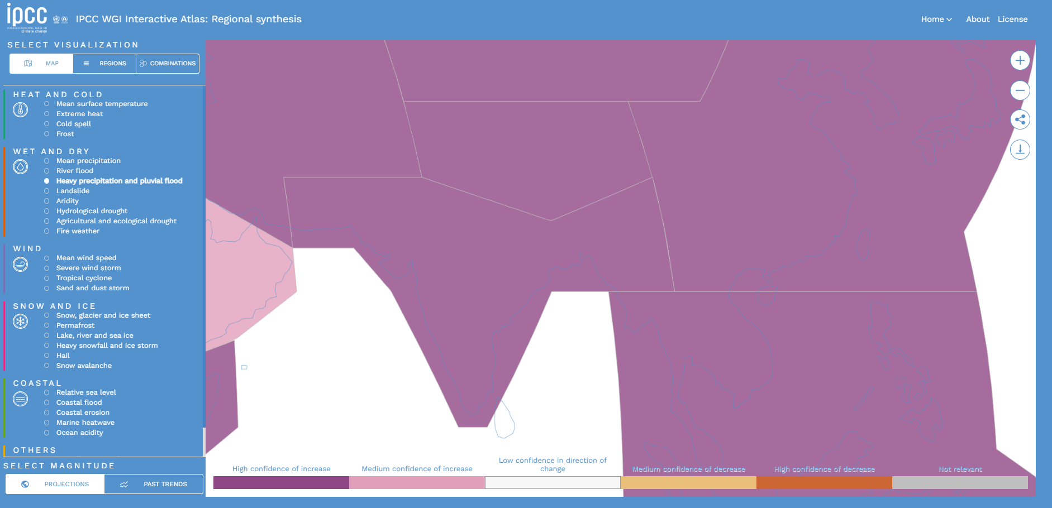
Background
Increased floods and droughts, together with heat stress, will have an adverse impact on food availability and prices, resulting in increased undernourishment in South and Southeast Asia (IPCC AR6: high confidence)
Fluvial Flooding
Pluvial Flooding

Slide 4
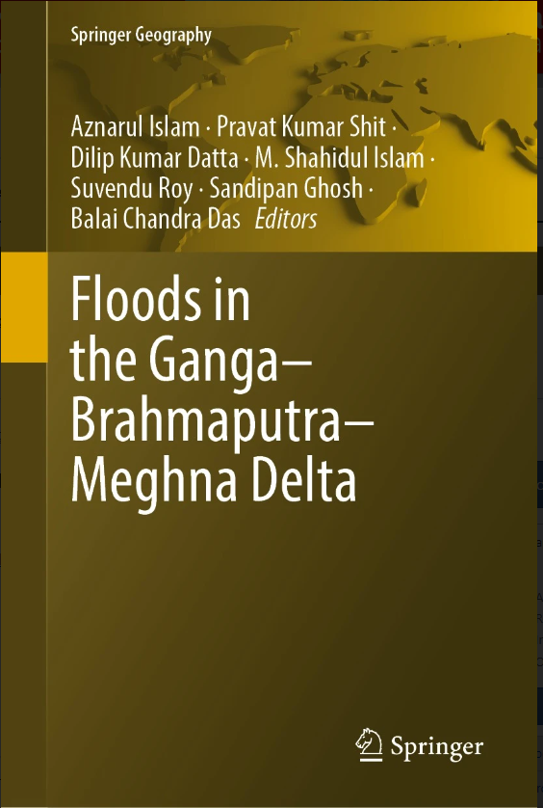
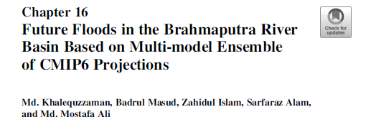
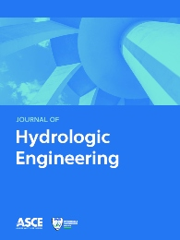
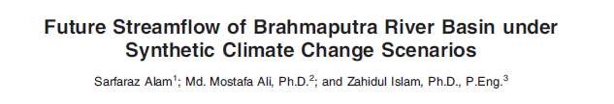
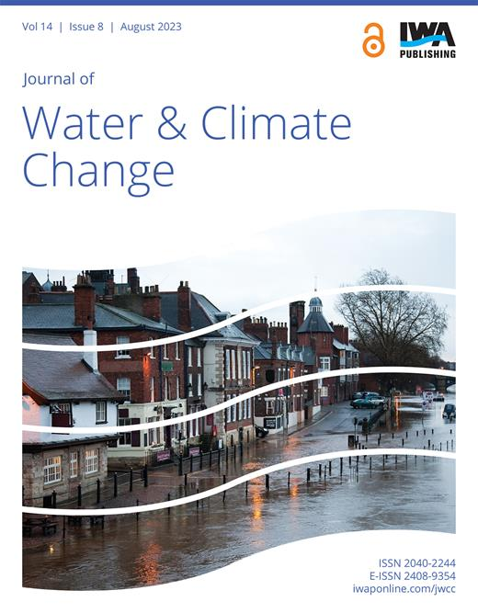
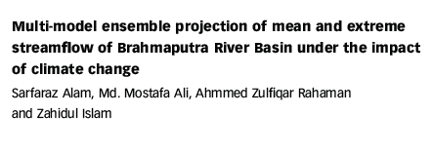
Scientific Integrity
Results and Methods presented here are peer-reviewed

Slide 5
Study Area & Key Objectives
Study Area
Brahmaputra River Basin
  Bahadurabad Station
Objectives
Basin scale changes in precipitation for future periods
The probability of extreme precipitation events for future periods
Future peak flows for various global warming scenarios (e.g., 1⁰ C, 1.5⁰ C, 2⁰ C, 2.5⁰ C)

Slide 6
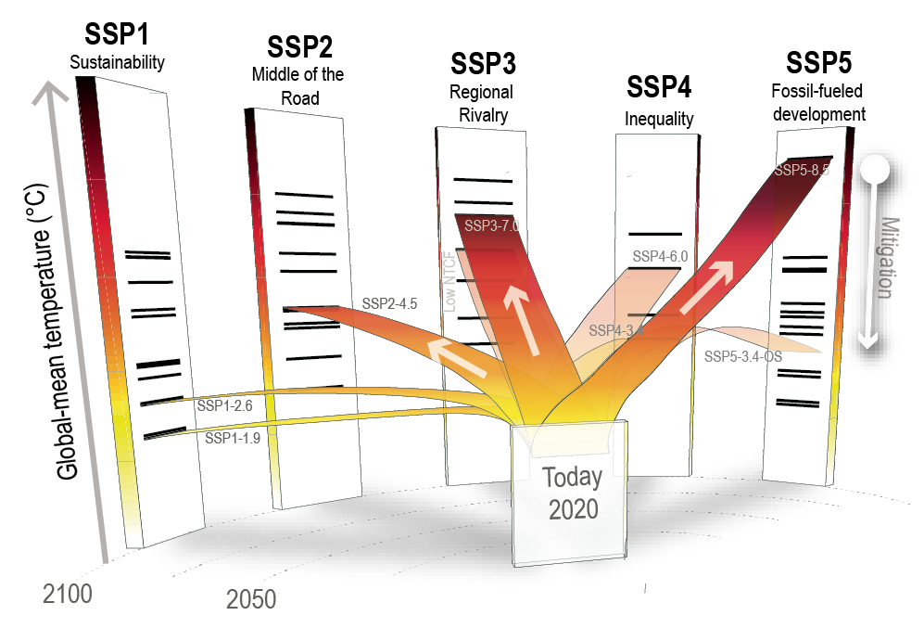
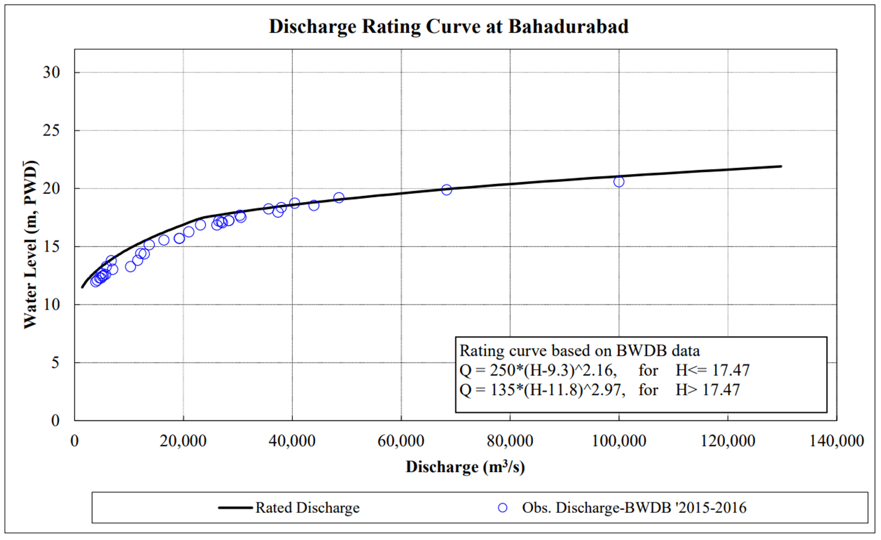
Data & Resources
Climate Data
9 GCMs through CMIP6
3 Shared Socioeconomic Pathways (SSPs)
  SSP126 (Sustainability)
  SSP245 (Middle of the road)
  SSP585 (Fossil-fuel development)
Hydrologic Model
Developed by Alam et. al (2021)
Rating Curve
Bahadurabad Station (BWDB)

Slide 7
Results

Slide 8
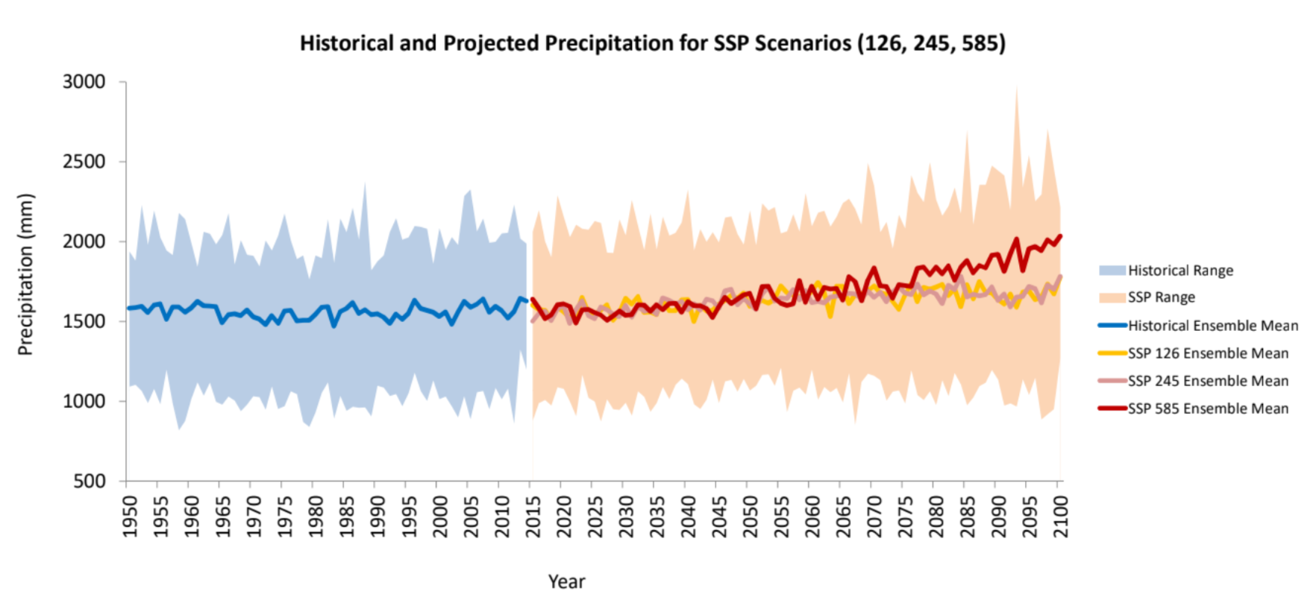
Changes in Basin Scale Precipitation
General increasing trend in mean annual precipitation

Slide 9
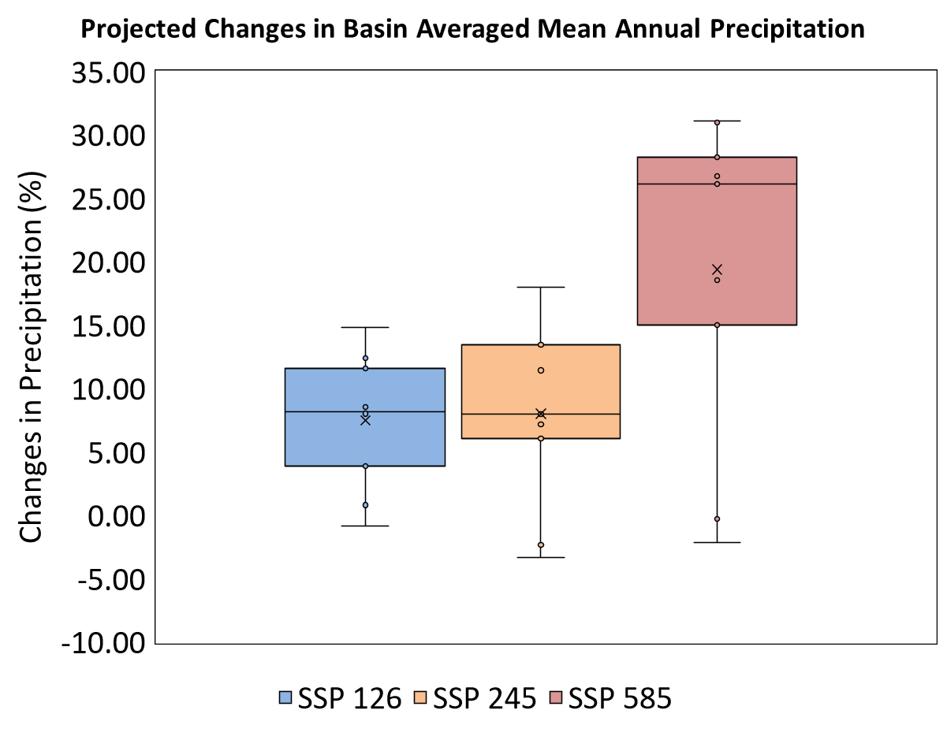
Changes in Basin Scale Precipitation
Mean annual precipitation changes in 2071-2100 compared to 1981-2010
SSP126: 7.48%
SSP245: 8.01%
SSP585: 19.37%

Slide 10
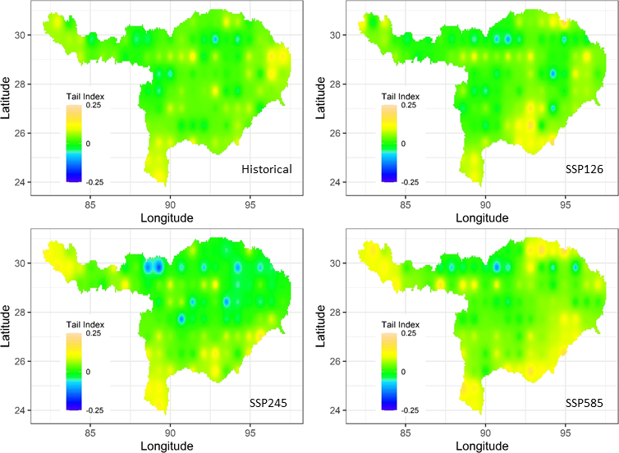
Changes in Extreme Precipitation
Tail Index (a statistical term) is a measure of more frequent extreme precipitation
Positive values (shades of yellow) signify more frequent extreme events
Notes:
A heavy tail (the shape parameter of GPD is greater than zero) implies a higher probability of more frequent extreme events.
Reason: enhanced tropical convective precipitation

Slide 11
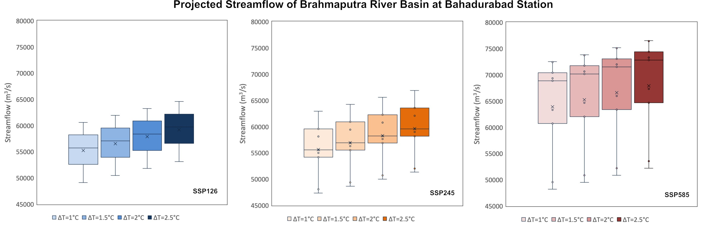
Changes in Peak Flows
General increasing trend

Slide 12
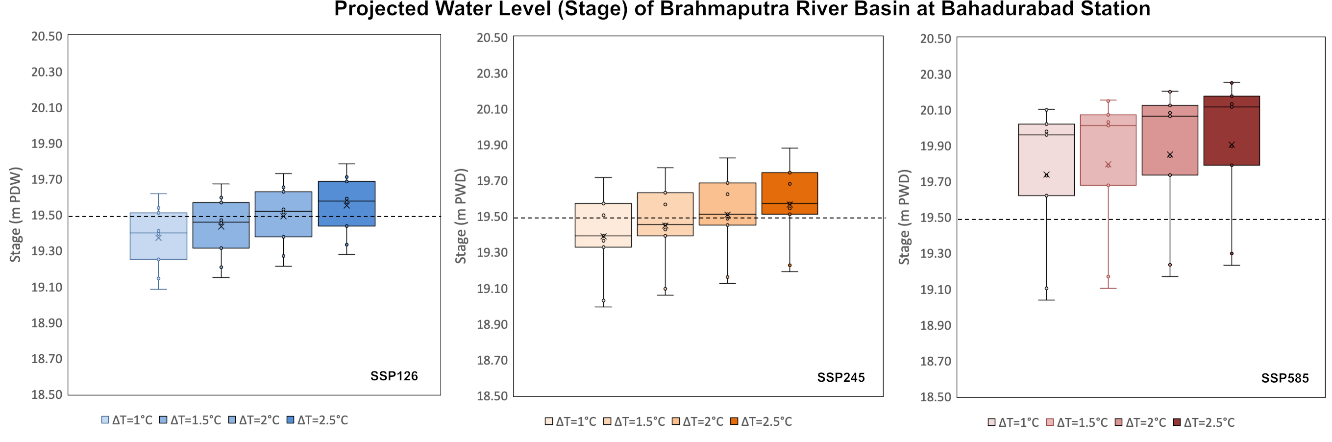
Changes in River Stage
General increasing trend
Current Danger Level

Slide 13
Highlights (Takeaways)
Mean annual precipitation is expected to increase from 7.5 % to 19% (sustainability to fossil fuel-intensive scenario) at the end of the 21st Century
More frequent extreme precipitation events are projected to occur
For 1.5-degree global warming in a fossil fuel-intensive world, the flood discharge in the Brahmaputra River at Bahadurabad is projected to increase by 39% at the end of the 21st Century

Slide 14
Questions
From Left: Prof. Md. Khalequzzaman, Dr. Badrul Masud, Dr. Zahidul Islam, Dr. Sarfaraz Alam, Prof. Md. Mostafa Ali

