Slide 1
Sedimentation Rates Versus Sea-level Rise at the Bangladesh Coast
Dipen Bhattacharya
Department of Natural Sciences Moreno Valley College California, USA

Slide 2
Premise:
Sedimentation rates in the Sundarbans and the fluvial delta exceed rates of relative sea-level rise (RSLR) and balances rates of RSLR augmented from tide range amplification. It seems the coastal areas are adapting to human-induced environmental change.
Does these rates commensurate with what we understand about the yearly sediment flow through the Bengal Basin?
To maintain this balance future sediment supply needs to be unimpeded.

Slide 3
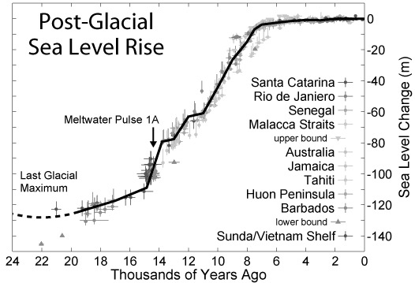
The sea-level has risen almost 120 m since the last Glacial Maximum (rates from 4 cm/yr to 1 mm/yr)

Slide 4
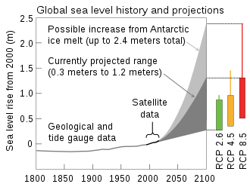
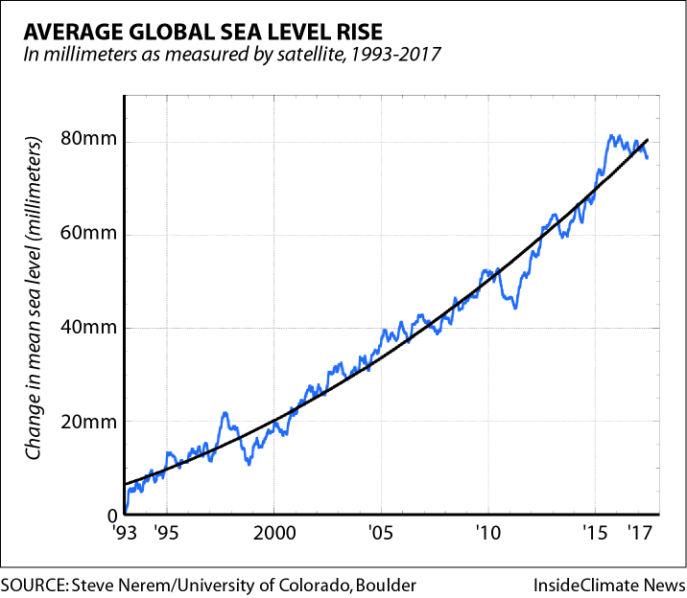
Current sea-level rise. 3.3 mm/yr ?

Slide 5
Or higher 4.8 mm/yr ? In effect, the effective sea-level rise at the Bangladesh coast is higher than 1 cm/yr.

Slide 7
Bhattacharya & Fraczek (2011)
The Bengal Delta coastline 12,000 years ago : extended 50–100 km south of the current coast

Slide 8
10,000 years before present. Lowest surface level : -57.5 m

Slide 9
9,000 years before present. Lowest surface level : -33.5 m

Slide 10
8,000 years before present. Lowest surface level : -23.5 m

Slide 11
7,000 years before present. Lowest surface level : -6 m

Slide 12
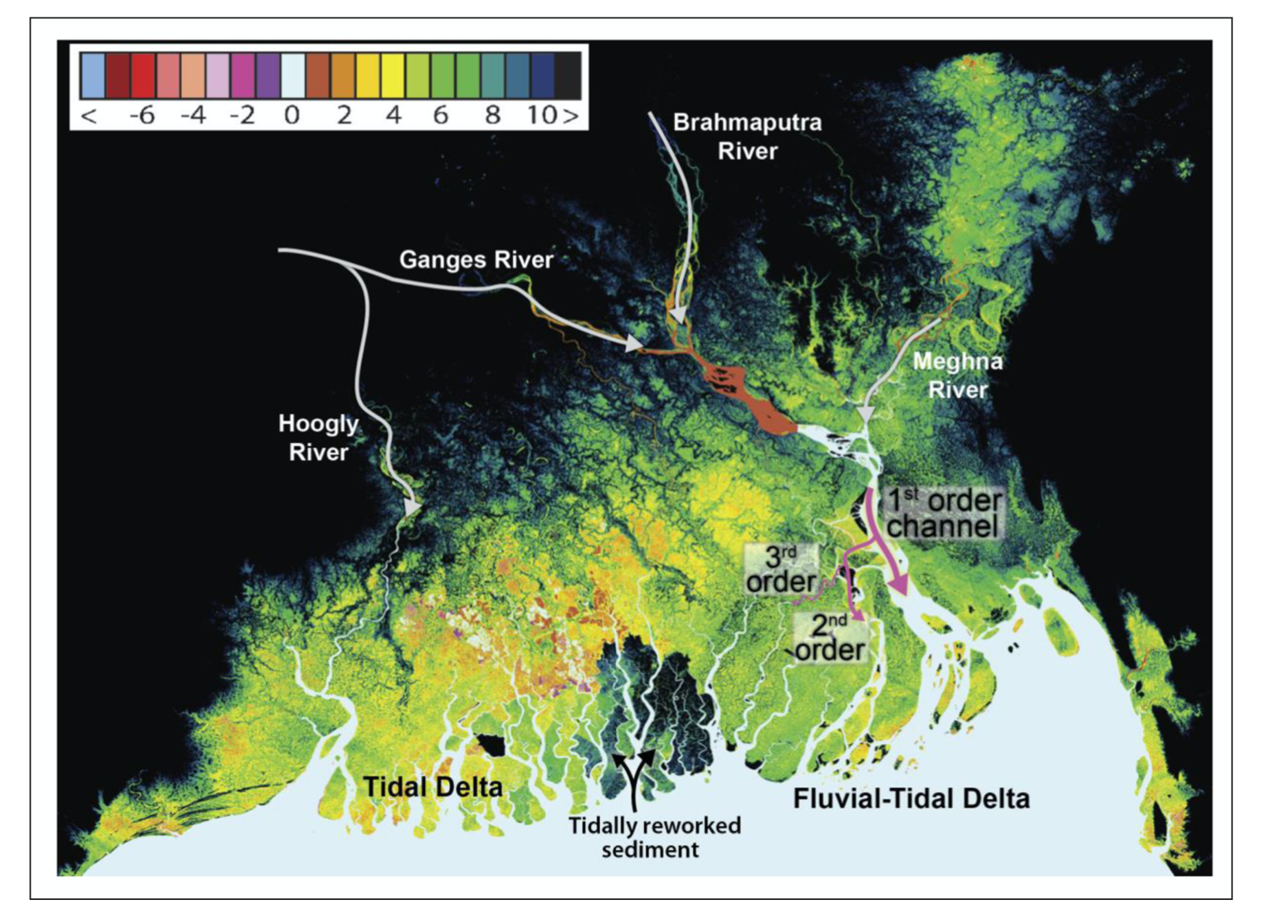
SRTM Digital Elevation Model
Rooger & Overbeem, 2017 Syvitski et al., 2009
Bhattacharya & Fraczek 2011

Slide 13
Sundarbans elevation
We considered a mixed forest where the tall forest is concentrated on the north-east of the region and the shorter one is on the south-east and western regions.
i) Using the publicly available BING data to ascertain the heights of the adjacent crop fields or cleared area and extrapolate them into the forest. ii) A general idea of the average tree heights of three different species (Sundari, Gewa, and Goran). Other species like Kankra and Shingra are found to be similar to Goran. iii) A general range of published Sundarban elevations (sea-level to 2 m in the southern section). Based on these three factors, the tall forest was corrected by 9 m and the short forest by 5 m. There were still some outlier points that exceeded the local average (15 m or more) that were manually corrected. The inherent SRTM vertical root mean square error which is on the order of a meter (or more) in this area.

Slide 14
Isopachs 11,000 ybp

Slide 15
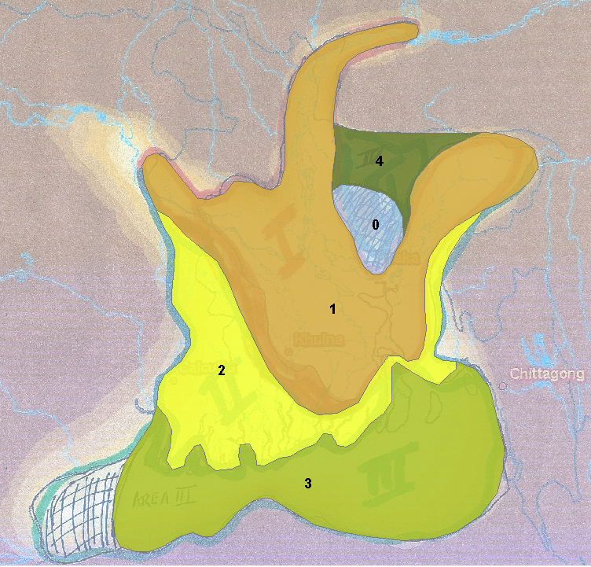

Slide 16
Sediment Estimates
Based on an estimated 10⁹ tons/yr sediment flow, we derived a spatially differentiated sedimentation rate of 3.1 mm/yr in the coastal area and 1.5 mm/yr elsewhere (Bhattacharya & Fraczek 2011).
The fluvial delta received 33 m of sediment over the last 9,000 years, i.e., 3.6 mm/yr.
But, for the present, can these estimations be off, especially in the coastal regions, by a factor of 6 or 7?

Slide 17
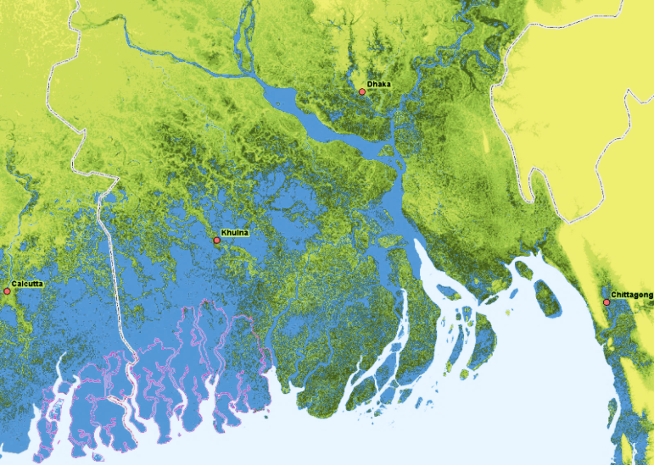
2 to 3 m sea-level rise : A simple model with nominal subsidence rates. 14% of the country is submerged.

Slide 18
But should we reassess our sedimentation rates?

Slide 19
Sufficient confusion remains with respect to the amount of sediment flow. WARPO/BUET - Research on Sediment Distribution and Management in South-West Region of Bangladesh (2020)

Slide 20
Allison & Kepple (2001)
Based on vibracores and auger samples collected from the lower tidal delta plain, estimated an accumulation rate of 1.1 cm/yr.

Slide 21
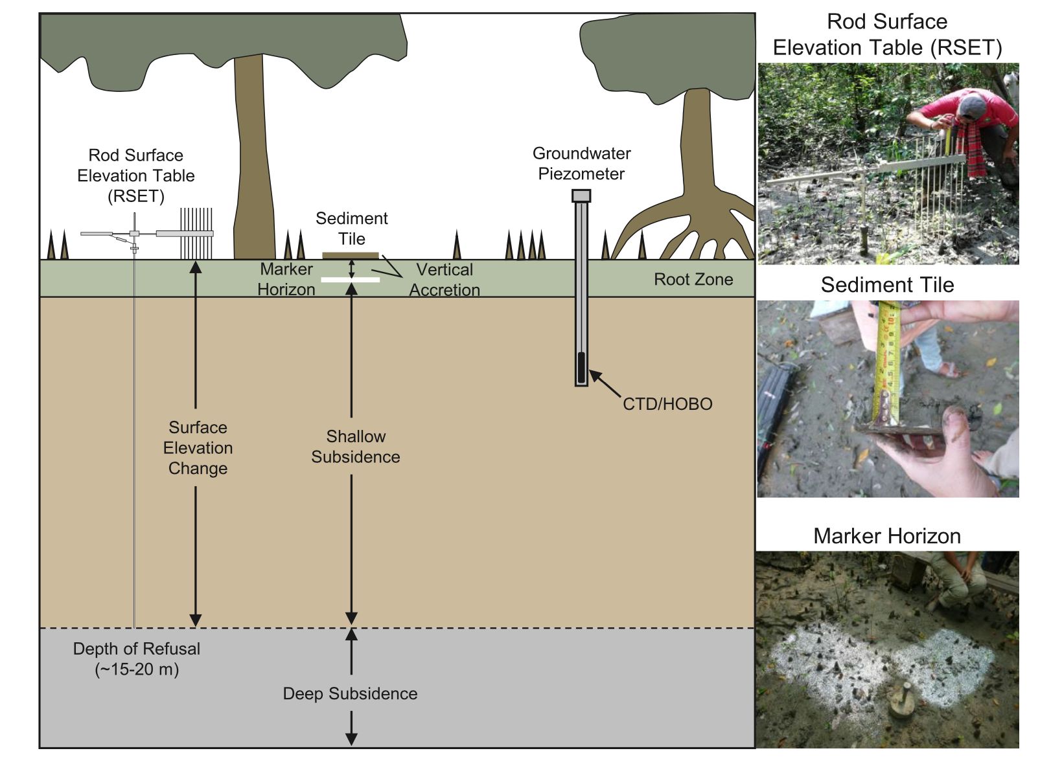
Bomer et al. (2020) Catena 187 104312 Sundarbans study
Elevation gain: in the natural streambank 2.16 ± 0.26 cm yr⁻¹ in interior of the mangrove forest 1.32 ± 0.17 cm yr⁻¹ These rates of elevation gain exceed that of Relative sea-level rise (0.9 cm yr⁻¹) and more closely follow the range of Effective sea-level rise 1.2–1.6 cm yr⁻¹

Slide 22
Surface elevation change compared to sea-level rise (x-axis 2014 – 2019) D – Dry M - Monsoon RSLR relative sea-level rise integrates the effects of eustatic sea-level rise and subsidence Effective sea-level rise includes the effects of RSLR plus tidal range amplification from embankment construction. (Bomer et al. 2020)

Slide 23
Roger & Overbeem (2017) found aggradation rates averaging 2.3 cm/yr in the flood plains of the lower central delta (30% sand, 20% silt, 50% clay)
They used Be-7 a short-lived cosmogenic radioisotopes (half-life = 53.3 days) for seasonal flood pulse.
Pb-210 (half-life = 22.3 days) is effective for identifying fluvial sediments deposited within the last 100 years.
This is more than the double the estimated local average sea-level rise > 1 cm/yr

Slide 24
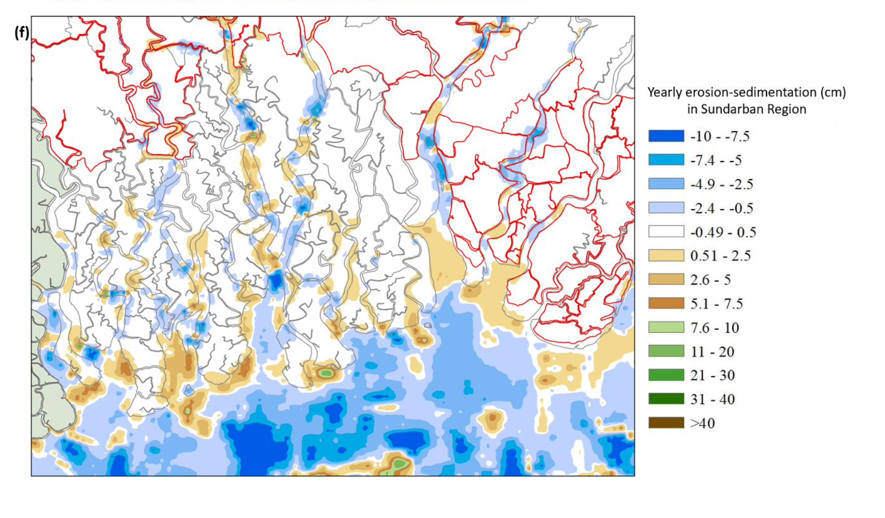
WARPO/BUET - Research on Sediment Distribution and Management in South-West Region of Bangladesh (2020) Delft3D Numerical Model

Slide 25
Auerbach et al. (2015)
The islands in the southwest Bangladesh, enclosed by embankments in the 1960s, have lost 1.0 – 1.5 m of elevation over a period of 60-years, whereas the neighboring Sundarban mangrove forest has remained relatively stable.
Sarker M. et al. (2011)
For the predicted rate of sea-level rise, for example 60–100 cm in the next 100 years, transgression of the sea in the Meghan estuary is not expected. In this situation, the rate of vertical accretion in the estuary would keep pace with the sea-level rise.

Slide 26
Fluvial + Tidal Delta 10,000 square km
An average of 0.25 billion tons of sediment needed for 1.5 cm sedimentation rate. (Density = 1.55 gm/cm³ with 50% mud content from Fleming & Delafontaine 2000)
This 25% of the yearly flow rate through Bengal Basin
In terms of orders of magnitude calculation this seems reasonable.

Slide 27
The change in coastal geography over a 20-year period (Rana M. S. 2012)

Slide 29
Allison (1998)
Over the last 7,000 years the Bengal Delta has prograded ~ 5 km²/yr
Sarker & Thorne (2006)
1776-1996 the Delta has prograded ~ 5 – 10 km²/yr
1973 – 2000 18.9 km²/yr
1996 – 2008 10 km²/yr
Hassan et al. (2017)
1973 – 2016 31.8 km²/yr

Slide 30
Sarker and Thorne (2006)
The increased rate of sediment accretion during the late 20th century at the Meghan estuary could be due to the Assam earthquake of 1950.
However, this calculation is based on Mathur (1953) that estimates the landslide earth volume was 45 x 10⁹ m³.
This seems to be an overestimation as 45 km³ of material could provide almost 35 years of nominal 10⁹ tonnes/yr
Marc et al. (2014)
Assam landslide volume to be 2 km³. [It’s still quite substantial]

Slide 31
So, what could be the reasons for this enhanced accretion process?
Deforestation (anthropogenic)
Landslides (anthropogenic and natural)
Preventing sediment deposition on the land (anthropogenic)
Extreme rainfall events (climate change)
Enhanced glacial melting and scouring (climate change)
Others ?

Slide 32
The Saddler Plot (1981) seems to say that the long-term sedimentation rates are on the order of ~ 1 mm/yr So, questions remain with the current overall sediment rate estimations

Slide 33
Thoughts out loud
We already know these: 1 Extensive data collection on sedimentation, subsidence, river flow parameters and sea level in order to establish sediment variability pattern.
2 Sediment needs to flow unimpeded through upper part of the Delta and settle in the fluvial delta and coastal areas. No large-scale structure that could impede the sediment flow. Multilateral understating about water and sediment flow with the upper riparian countries. Adaptation:
3 Restructuring of population distribution pattern.
4 Restructuring of agricultural pattern
5 Restructuring of housing

Slide 34
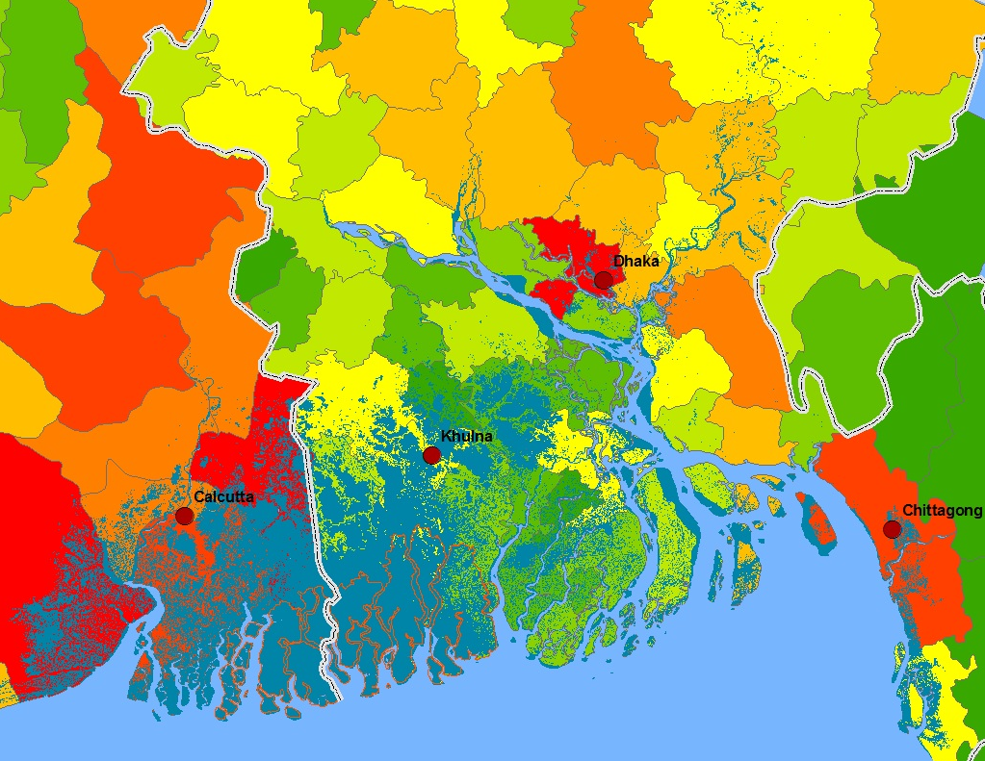
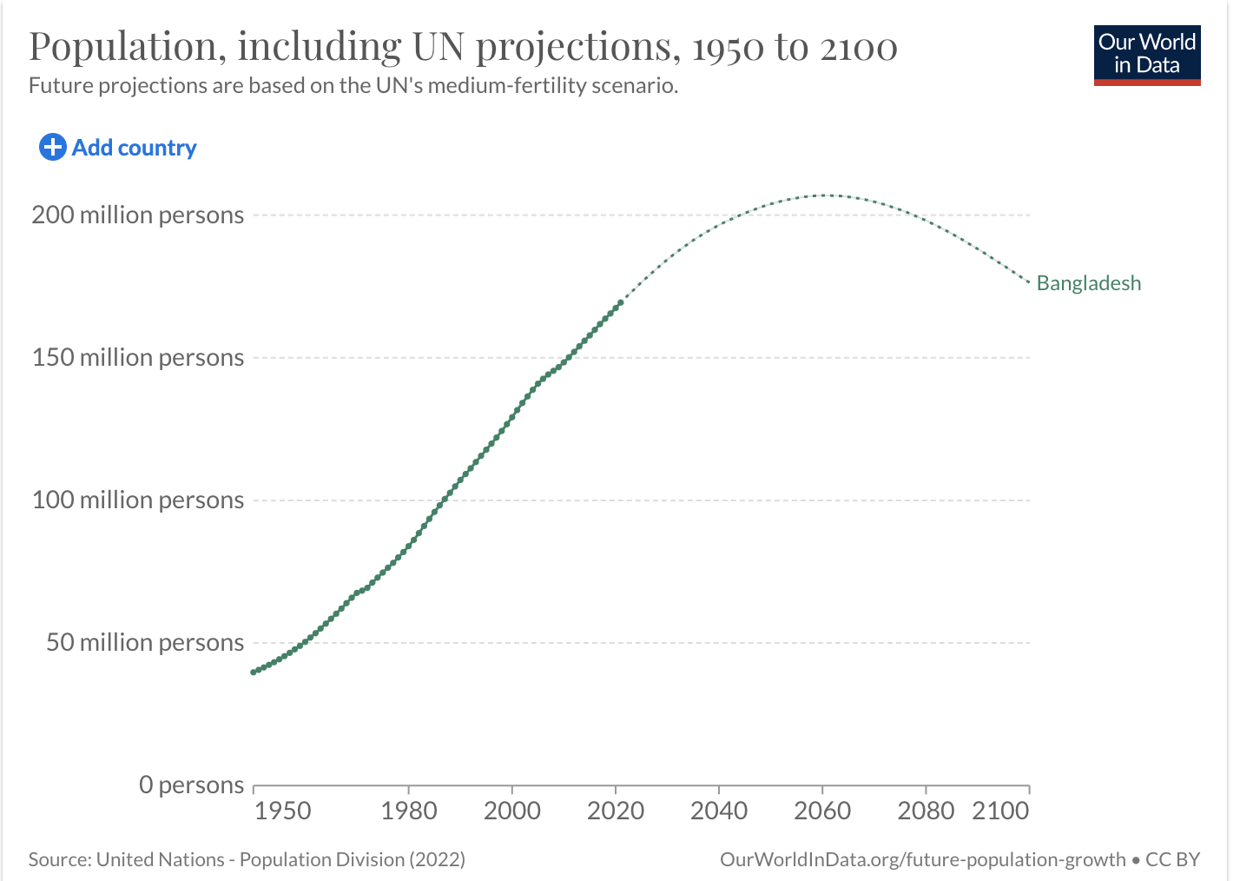
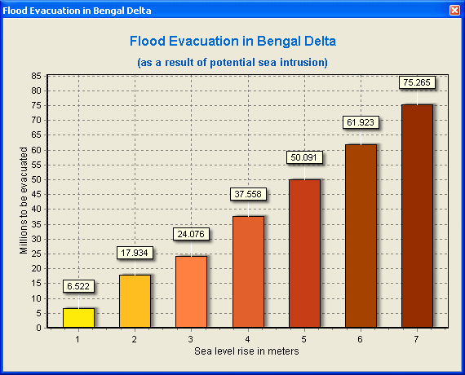
Population of the country will start to decline after 2060.

Slide 35
“Since the 1960s, ~5000 km² of tidal delta plain in southwest Bangladesh has been embanked and converted to densely inhabited, agricultural islands (i.e., polders). We reveal that >600 km of these major waterways have infilled in recent decades, converting to land through enhanced sedimentation and the direct blocking of waterways by embankments and sluice gates. The infilled channels account for ~90 km² of new land in the last 40–50 years, the rate of which, ~2 km²/yr, offsets the 4 km²/yr that is eroded at the coast, However, benefits are tempered by the loss of navigable waterways for commerce, transportation, and fishing, as well as the forced rerouting of tidal waters and sediments necessary to sustain this low-lying landscape against rising sea level.” (C. Wilson et al. 2017).
One final thought: One has to be careful in terms of how the harmful effects of polders can be mitigated. It might require bigger perspective than TRW or TBM.

